Slide 1
International Home Garden Conference
Venlo, the Netherlands
2012

Slide 2
Background of IHGC
Goal:
To assist members to grow their business by stimulating
Home Garden as being:
*Fun
*Easy
*Economical
*Valuable
Platform:
To be hosted by the Fleuroselect Home Garden Business Unit.
*Established organization
*Common goals

Slide 3
2012 IHGC Attendees
50 Companies, 70 Participants
16 Nationalities
Austria, Belgium, Cyprus, Czech Republic, France, Germany, Hungary, India, Poland, Romania, Russian Federation, Sweden, Switzerland, The Netherlands, United Kingdom, USA

Slide 4
2012 IHGC Attendees
NOTE:
Company activities can be more than 1
For example
Company X can be both breeder and seed production company

Slide 5
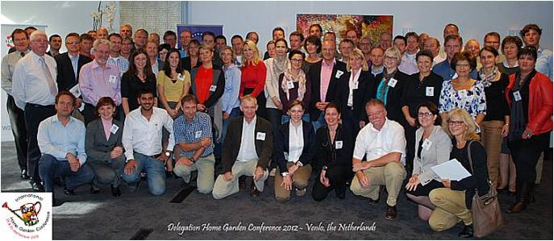

Slide 6
2012 Themes
Sustainability in business
Consumer Education

Slide 7
Talking the Talk
- Nico Koomen: The Floriade, a world horticultural exhibition
- Sven Stimac: Organizing the Floriade with sustainability as the central theme
- Nico Wissing: Introduction to the sustainable garden
- Andrew Jenkins: Whole life product sustainability - the retailers view

Slide 8
Sustainability in Business means…
Community – Environmental – Economical
Balance

Slide 9
Community
Fair and beneficial business practices toward labor and the community.
Environment
Sustainable practices to minimize environmental impact.
Economy
Value created by the organization plus economic benefit enjoyed by the society.

Slide 10
2012 Themes
Sustainability in business
Consumer Education

Slide 11
Talking the Talk
- Harm Custers: Sustainability and Home Gardening - conference introduction
- Shawna Coronado:
Creative sustainable gardening ideas
How to use social media to build an intimate consumer connection
- Nico Wissing: Introduction to the sustainable garden

Slide 12
Educating Consumers …on the benefits of (sustainable) gardening
Personal Benefit
Environmental Benefit
Saves money (home raised produce)
Improves health- mental/physical
Raises home value
Beautifies neighborhoods
Brings entire communities together
Promotes native plants and wildlife- Biodiversity
Requires less $/time input
Preservation & Conservation
Organic solutions
Seasonal & Regional crops

Slide 13
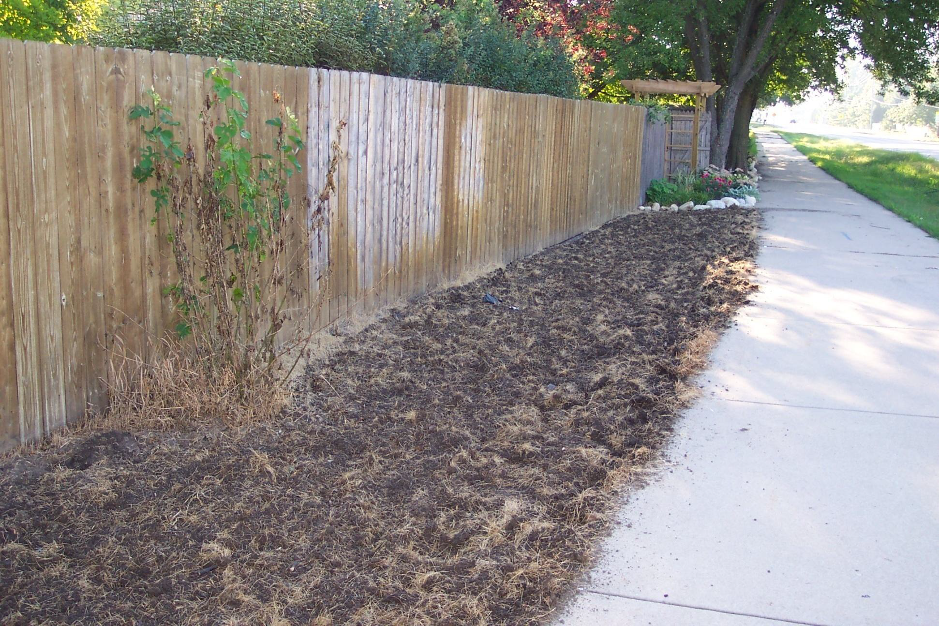

Slide 14
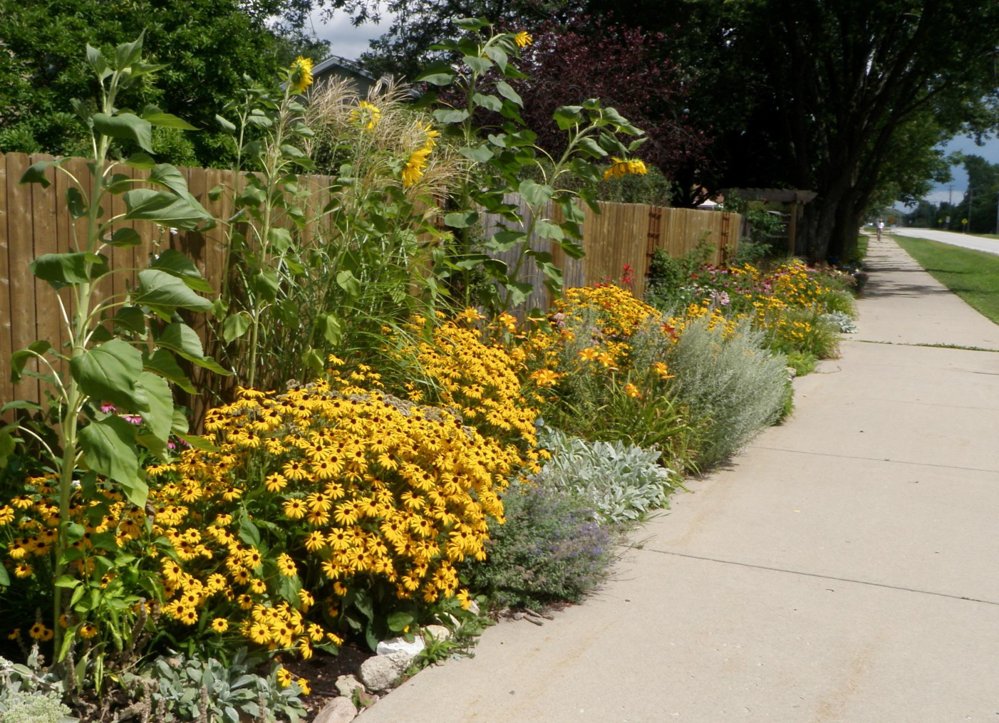

Slide 15
Profiting from Sustainability – Professionally & Personally
Financial Merit
Environmental Merit
Lifestyle Benefits
Emotional Merit
Physical Merit
Leads to a Long-Term Profit for All
Merging Economy & Ecology into One System

Slide 16
Floriade
Horticultural World Expo, once every 10 years
Founded by the Dutch Horticultural Society in 1950
2012 Theme: “Theater of Nature”
170 acres of park, 100 acres of show grounds
5 Theme Worlds
This decennial event centers on sustainability
and innovation and acted as a backbone to
selecting the IHGC theme this year.

Slide 17
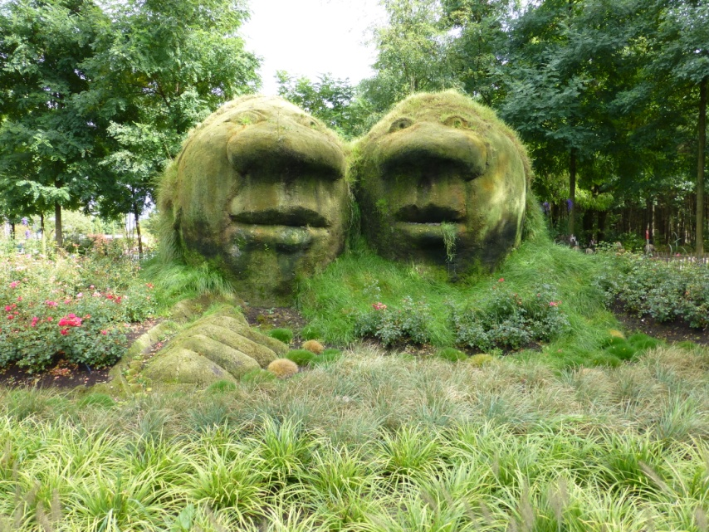
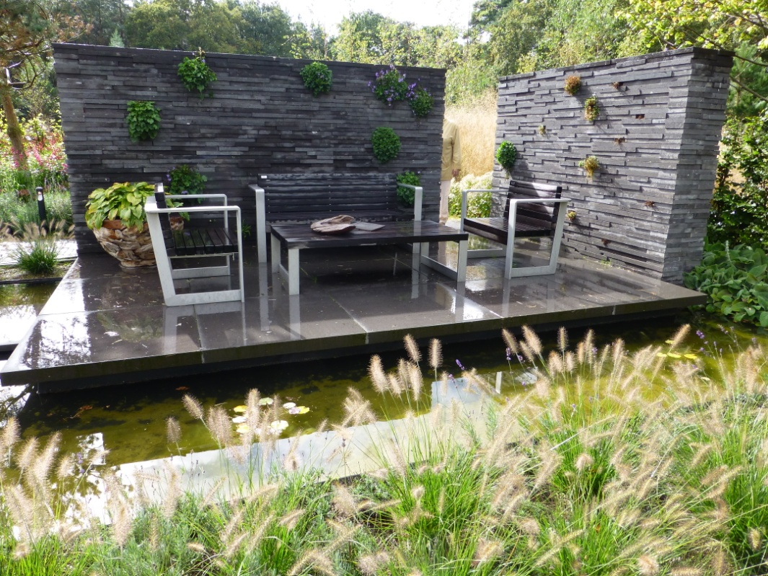
Relax & Heal
The importance of horticulture for health and wellbeing.

Slide 18
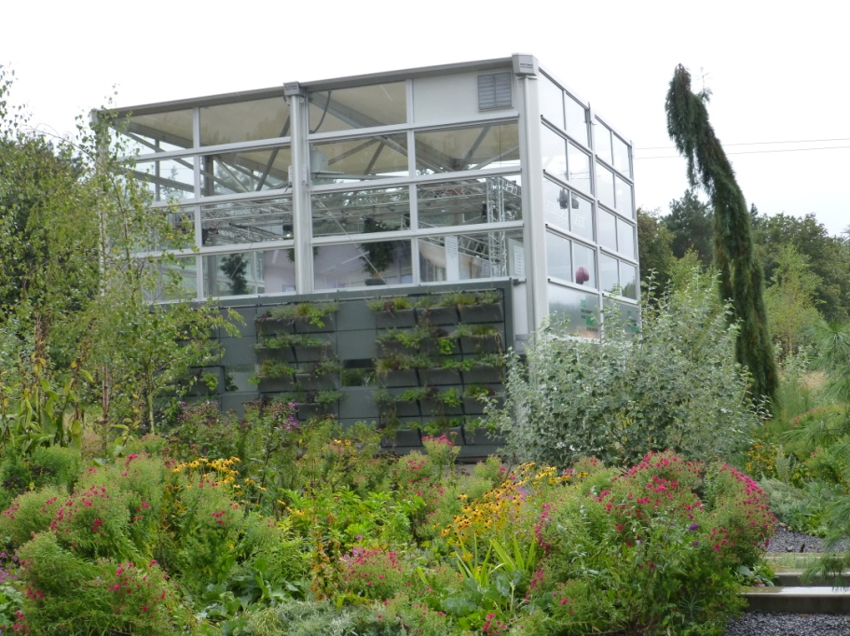
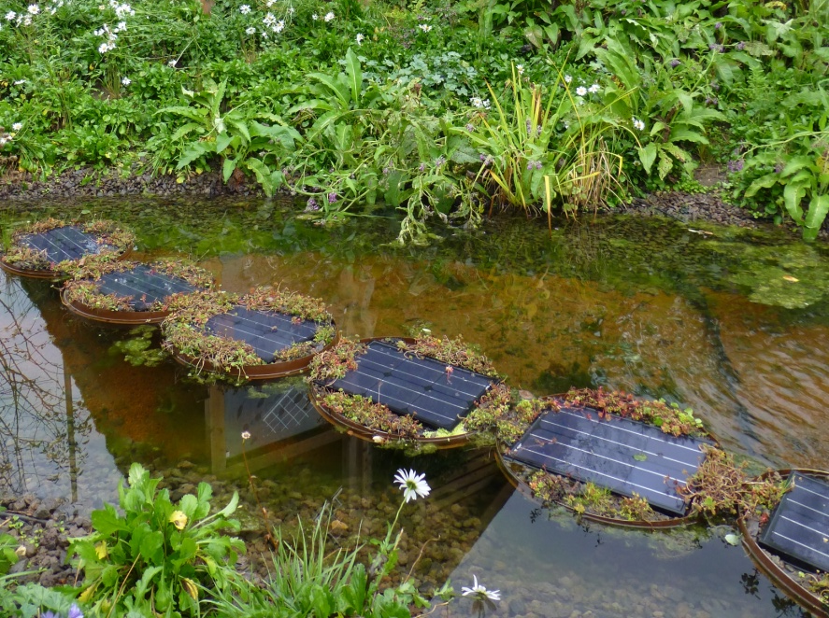
Green Engine
Horticulture as an important economic engine and supplier of green energy.

Slide 19
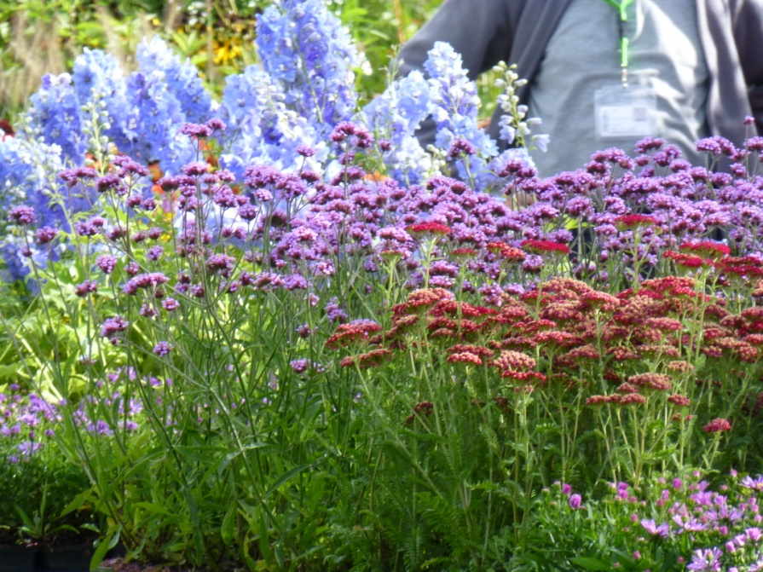
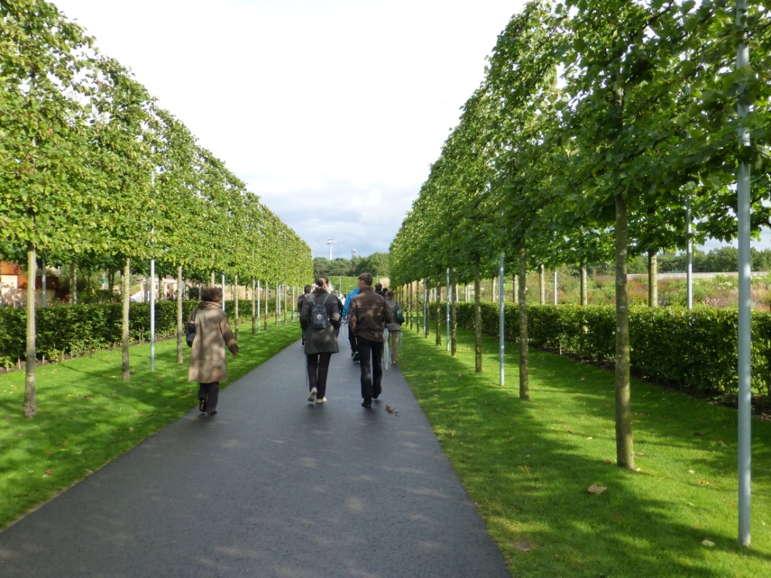
Environment
The enormous contribution of a green working and living environment to our quality of life.

Slide 20
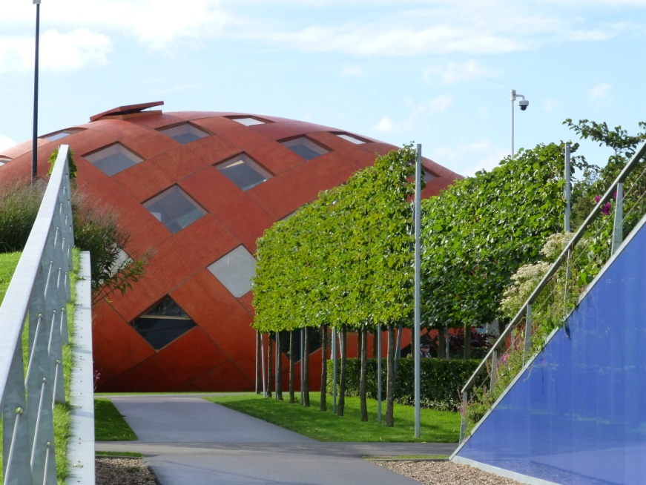
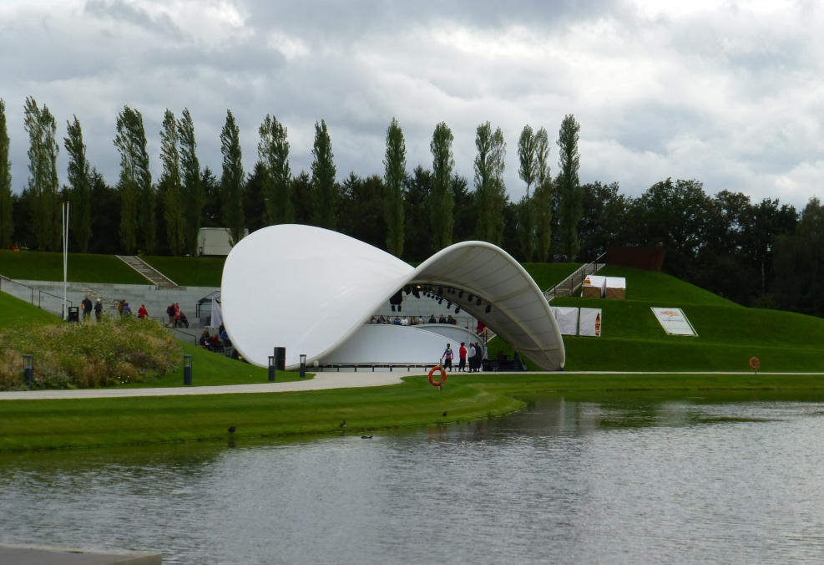
Education & Innovation
The relation between innovation & education.

Slide 21
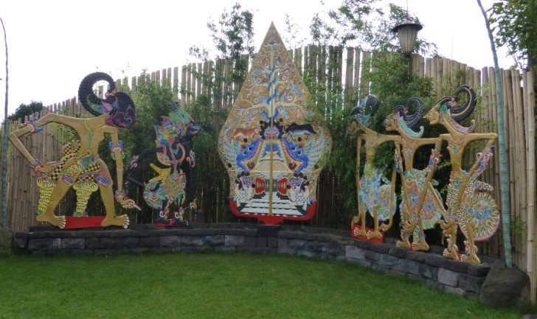
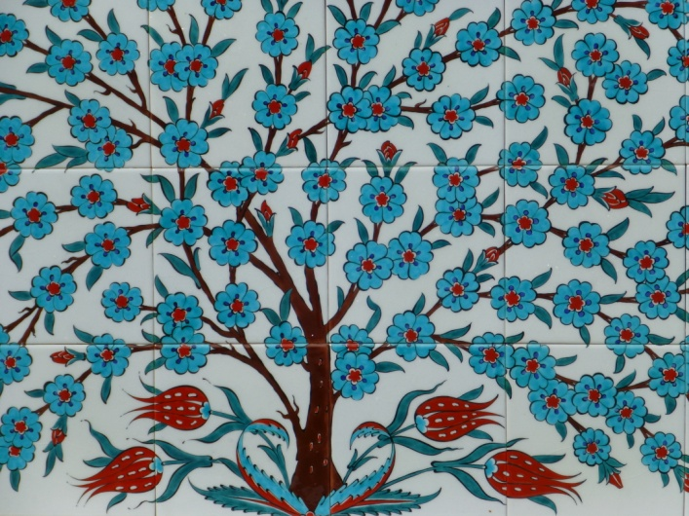
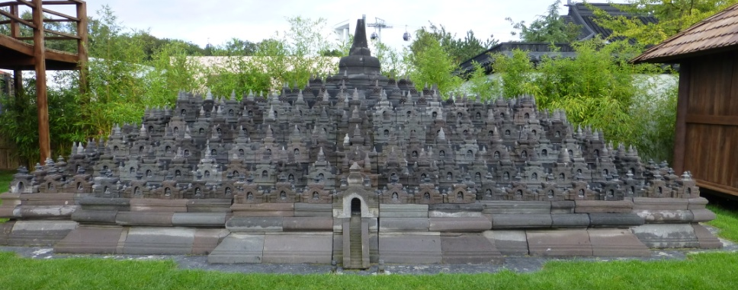
World Show Stage
Nature as a source of inspiration, fun and entertainment.

Slide 22
As the conference wrapped up a discussion on the direction of the IHGC opened. Members were polled about interest in garden trials and awards. As a result the IHGC is considering a ‘Vegetable of the Year’ and ‘Flower of the Year’ medal program.

Slide 23
Initial Proposal:
Companies/Breeders enter varieties:
A large trial in each country
A pre-committed press campaign
An awarding system
?? Still debating focus: direct sow, transplant, or combination ??

Slide 24
Reasons to Attend IHCG 2013 (UK)
New Ideas and Inspiration
International trial location opportunities for members
Potential for variety awards and recognition
Opportunities for Business with Foreign Delegates
Lines up with Dutch vegetable breeding trials
Option to explore The Netherlands , Germany, UK & more…

Slide 25
Promoting Home Gardening as being fun, easy, economical and valuable is the greatest goal of the International Home Garden Conference. A special membership rate for companies who have not yet joined the organization will be available. For more information contact: info@fleuroselect.com.

Slide 26
Presentations in .pdf available for downloading: - Harm Custers: Sustainability and Home Gardening - conference introduction - Nico Koomen: The Floriade, a world horticultural exhibition - Sven Stimac: Organising the Floriade with sustainability as the central theme - Shawna Coronado: Creative sustainable gardening ideas - part 1 - Shawna Coronado: Creative sustainable gardening ideas - part 2 - Nico Wissing: Introduction to the sustainable garden - part 1 - Nico Wissing: Introduction to the sustainable garden - part 2 - Andrew Jenkins: Whole life product sustainability - the retailers view - Jan Geuns: Stevia - Peter Gajdostin: Home Gardening in the Czech Republic and Slovakia - Xavier Vandame: International Home Garden Association - Shawna Coronado: How to use social media to build an intimate consumer connection
To view PDF of presentations:
Right Click on any link above and select ‘Open Hyperlink’

